Slide 1
Adventure Productions Inc
A Leader In Innovative Walk-Through Adventures
Hickey's
Wild Adventure
Wild Adventure
Wayne Hickey – founder/owner
Adventure Productions inc
Myrtle Beach, SC 29579
843-655-0366
Email: adventuretower@aol.com

Slide 2
Hickey's
Wild Adventure
Wild Adventure
WHO ARE WE
We are Adventure Productions, Inc, a start-up company seeking to begin a journey into our 1st Family Entertainment Center offering a turn-key, interactive & interchangeable attractions to Theme Parks, Family Entertainment Centers, Hotels, Casinos and other start-up operations as franchisees.
www.hickeyswildadventure.com Adventure Productions Inc – Confidential – 1/15/2011

Slide 3
Hickey's
Wild Adventure
Wild Adventure
We offer our customers of all ages Wild Thrills & Adventures!
AND We Will Sell Emotion
Emotion Is The
Most Powerful Sales tool
In The World!
www.hickeyswildadventure.com Adventure Productions Inc – Confidential – 11/15/2011

Slide 4
Hickey's
Wild Adventure
Wild Adventure
Adventure Productions, Inc will become a leader in interchangeable Interactive Adventures!
Entering one of our Adventures/attractions will launch the participants into a nearly virtual world. The visitor will become transported into a sea of technology, interaction, and excitement. This new state of the art technology will carry us into the future; bringing repeat customers back for more through our ability to change/move sets, scenes, adventures, interaction, challenges and events at any given moment WE choose! The suspense of the unexpected will lure your repeat revenue/customers into another round of exciting Adventures over and over again! No other company has accomplished this process. Our initial objective will include a patent and a build out of our attraction.
www.hickeyswildadventure.com Adventure Productions Inc – Confidential – 11/15/2011

Slide 5
Hickey's
Wild Adventure
Wild Adventure

Slide 6
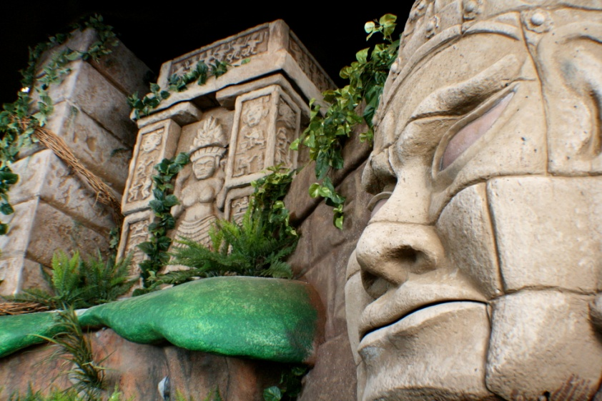
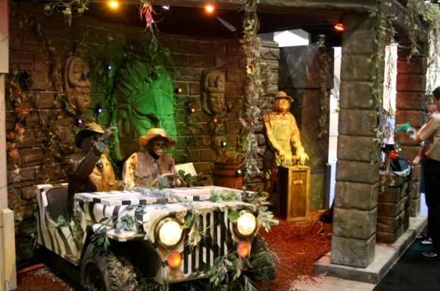
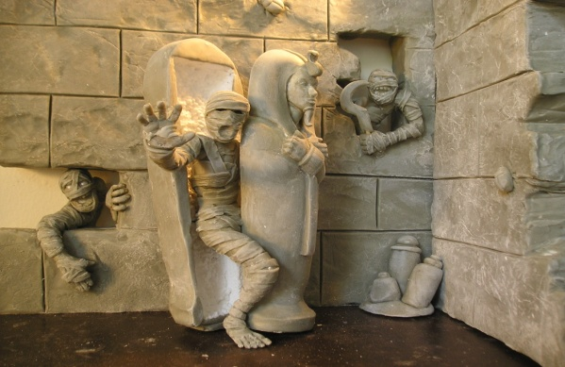
Adventure Productions Inc
A Leader In Innovative Walk-Through Adventures
Let Your Adventure Start Here!

Slide 7
Adventure Productions Inc
A Leader In Innovative Walk-Through Adventures
This “Product” has no limitations! We plan to create an Interactive Adventure for any topic either customized or generic depending on the franchisee. Dimensions and space availability will not be an issue or stand in the way of progress, leaving the sky as the limit to creativity and client/customer requirements. As a Franchise, we offer custom designs at various multi-level packages/plans.

Slide 8
Adventure Productions Inc
A Leader In Innovative Walk-Through Adventures
OUR BUSINESS MODEL
PATENT & LICENSE OUR PROCESS OF AN INTERCHANGEABLE-INTERACTIVE-ATTRACTION
BUILD & OPERATE A SUCCESSFUL FEC
FRANCHISE OUR TURN-KEY SYSTEM

Slide 9
Adventure Productions Inc
A Leader In Innovative Walk-Through Adventures
Statistics show within the United States:
There are over 500 Chuck E Cheese franchises
An estimated 10,000 FEC’s
Over 300 Theme Parks

Slide 10
Hickey's
Wild Adventure
Wild Adventure
WHERE ARE WE CURRENTLY
We are in negotiations to lease 23,000sq/ft space Myrtle Beach, SC.
Why this location:
Myrtle beach is a prime tourist destination with over 14 million visitors generating $8 billion revenue annually!
www.hickeyswildadventure.com Adventure Productions Inc – Confidential – 11/15/2011

Slide 11
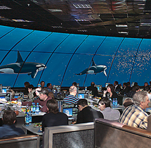
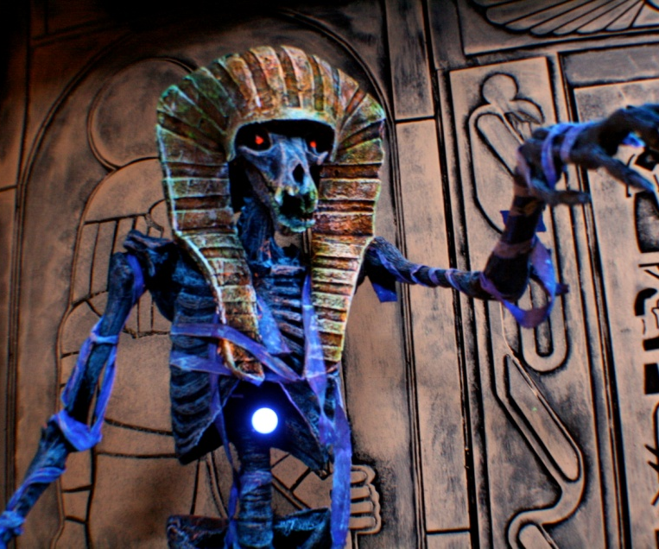
Adventure Productions Inc
A Leader In Innovative Walk-Through Adventures
Three New Attractions In One Place!
23,000 sq/ft Family Fun Center

Slide 12
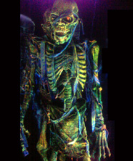
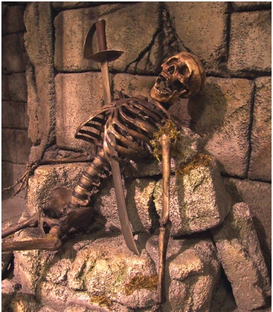
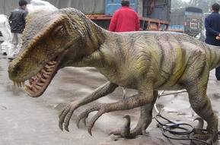
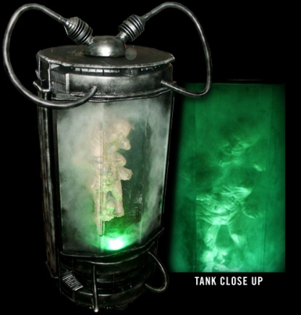
Hickey's
Wild Adventure
Wild Adventure
You Haven’t Seen
Anything Like This
Before!
www.hickeyswildadventure.com Adventure Productions Inc – Confidential – 11/15/2011

Slide 13
Hickey's
Wild Adventure
Wild Adventure
Adventure Productions, Inc is seeking $500,000 in initial seed capital in return for 25% equity, to apply for patent protection on our process, and to secure financing of an SBA loan for our start-up Family Entertainment Center in Myrtle Beach, SC. Total cost for our FEC is $2,135,000. This FEC will feature the first 7,000 sq/ft Interchangeable Interactive Wild Adventure, a 6,000 sq/ft Interactive Wild Café and a 6,000 sq/ft Wild PlayHouse arcade.
This is not an offer or advertisement to sell securities. Offer is made by prospectus & only to SC residents.
www.hickeyswildadventure.com Adventure Productions Inc – Confidential – 11/15/2011

Slide 14
Hickey's
Wild Adventure
Wild Adventure
Family Entertainment Centers (FECs) host an average of 381,000 guests annually, with the larger facilities hosting up to 622,000 guests annually. FECs also experience comparatively high levels of repeat visitation—more than three visits per season.
*According to 2011 International Association of Amusement Parks and Attractions

Slide 15
Hickey's
Wild Adventure
Wild Adventure
We are projecting a conservative breakeven point of .6% of 11,000,000.
We believe we can achieve a target return between 2-4% of 11,000,000 visitors to, Myrtle Beach, SC.
Achieving these numbers would potentially triple or quadruple the investors’ initial investment in one-year.
www.hickeyswildadventure.com Adventure Productions Inc – Confidential – 11/15/2011

Slide 16
Hickey's
Wild Adventure
Wild Adventure
Projected Financial Plan Highlights

Slide 17
Hickey's
Wild Adventure
Wild Adventure
A New & Unique Attraction
Completely Interchangeable & Interactive
State-Of-The-Art Animatronics
Five Years Of Development & Research
Low Initial Investment With High Projected ROI
A Committed Management Team
A Turn-Key Operation With Plans For Franchising
www.hickeyswildadventure.com Adventure Productions Inc – Confidential – 11/15/2011

Slide 18
Adventure Productions Inc
A Leader In Innovative Walk-Through Adventures
WHERE ARE WE GOING
Once we have secured financing patents will be filed
We will begin production of our flagship F E C
2. After our first year of operation we will begin to look at Franchising and market our business model at Trade Shows
3. Adventure Productions, Inc is currently in final negotiations with a new Adventure Park that is looking to license our Wild Adventure, Wild Café, and Wild PlayHouse along with several other themed attractions;.

Slide 19
Adventure Productions Inc
Hickey's
Wild Adventure
Wild Adventure
OWN A PIECE OF THE
WILD ADVENTURE!
Grand Opening May 2012
This is not an offer or advertisement to sell securities. Offer is made by prospectus & only to SC residents.
www.hickeyswildadventure.com Adventure Productions Inc – Confidential – 11/15/2011

Slide 20
Contact Information
Organization: _Adventure Productions Inc
Individual: _Wayne Hickey
Title: _Founder/Owner
Address 1: _2474 Windmill Way
City: _Myrtle BeachState:SC
_Zip Code: _29579
Email Address: adventuretower@aol.com
Mobile Telephone: _843-655-0366
Work Telephone: _843-655-0366
Website: _www.hickeyswildadventure.com
Notes:
20

Slide 21
Adventure Productions Inc
DISCLAIMERS
Ownership of Intellectual Property
The presenter or the organization, any predecessor organization, or any principal of the organization or any predecessor organization, presently is not the subject of any pending or threatened lawsuit, especially a lawsuit involving the organization’s intellectual property or other material assets, a non-competition or non-disclosure agreement, or the federal or state securities laws?
Legal actions outstanding
The presenter or the organization, any predecessor organization, or any principal of the organization or any predecessor organization, is not the subject of or involved (other than as a plaintiff or a witness) in any pending or threatened bankruptcy action, criminal conviction (other than routine traffic citations), or lawsuit, governmental investigation or administrative action relating to securities law violations, fraud, embezzlement, or other financial impropriety?
Notes:
21

